Slide 1
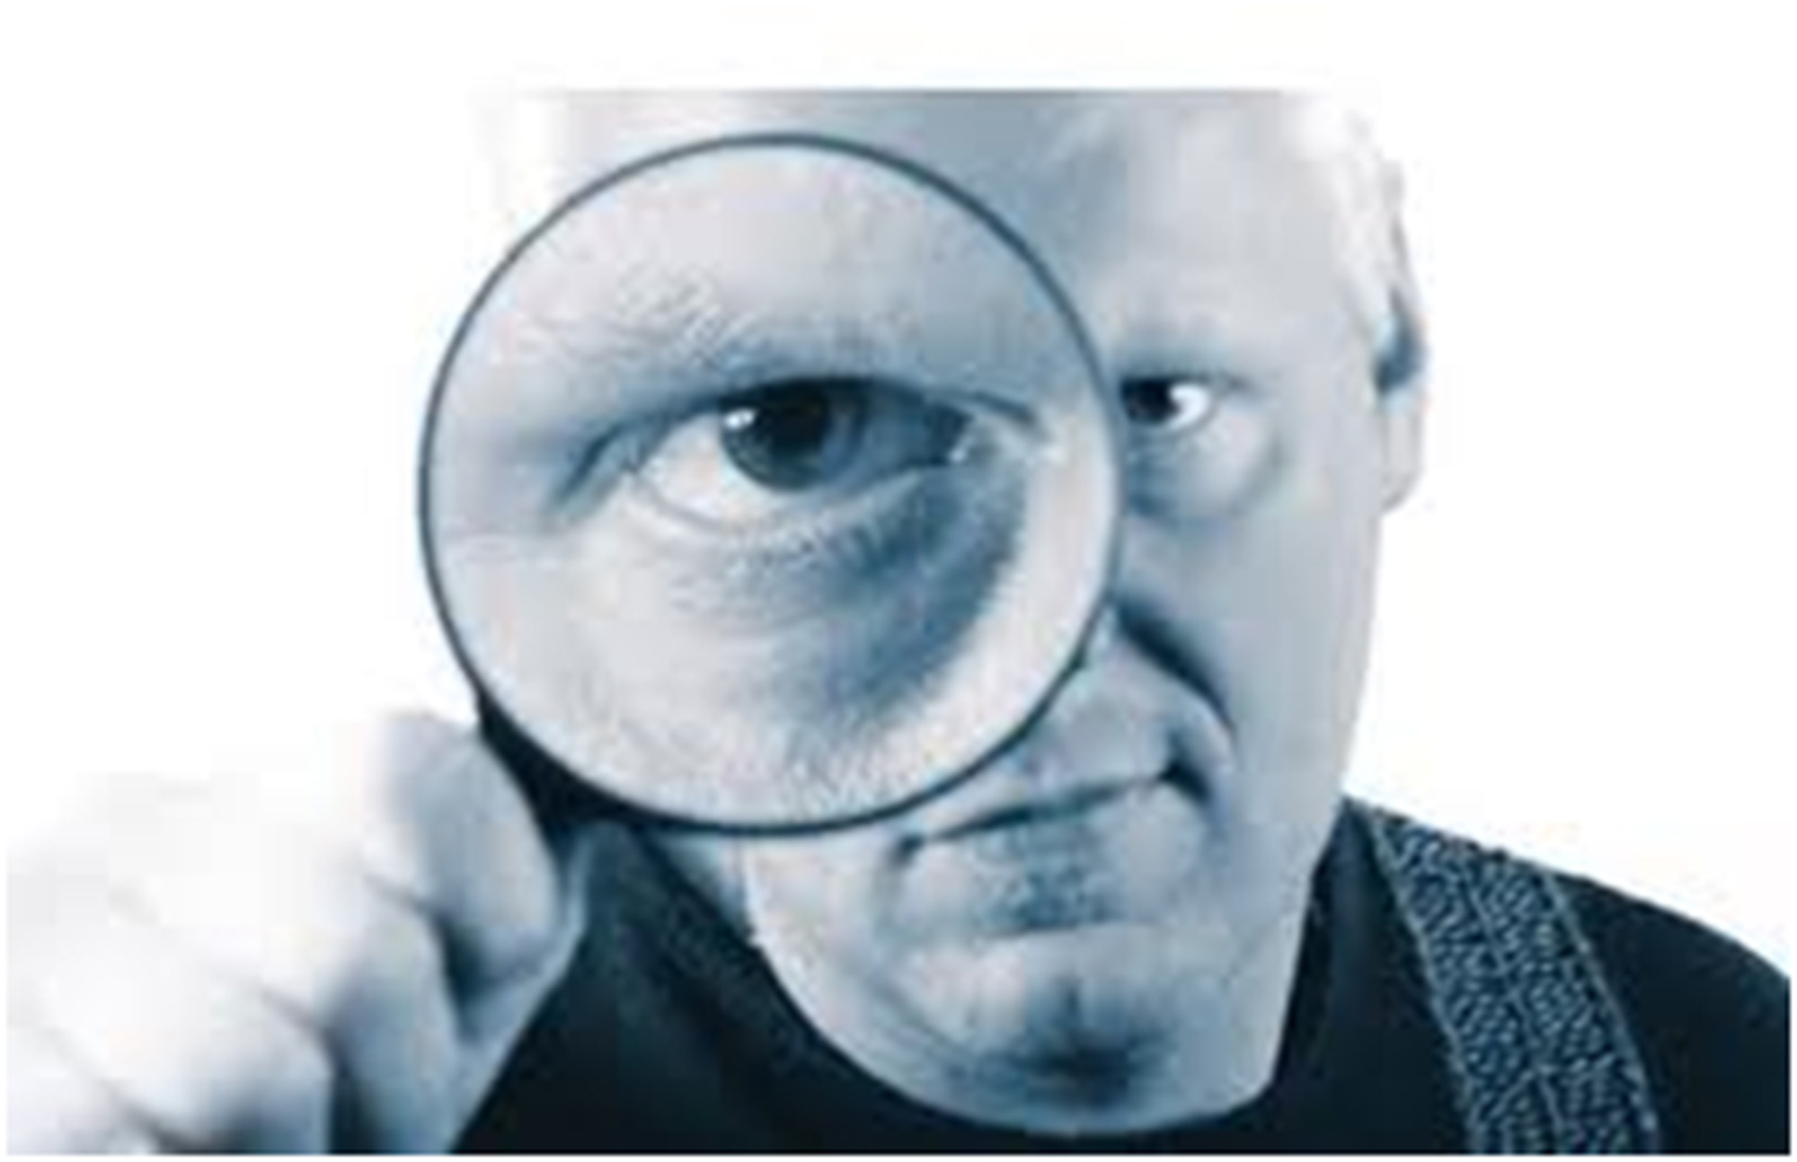
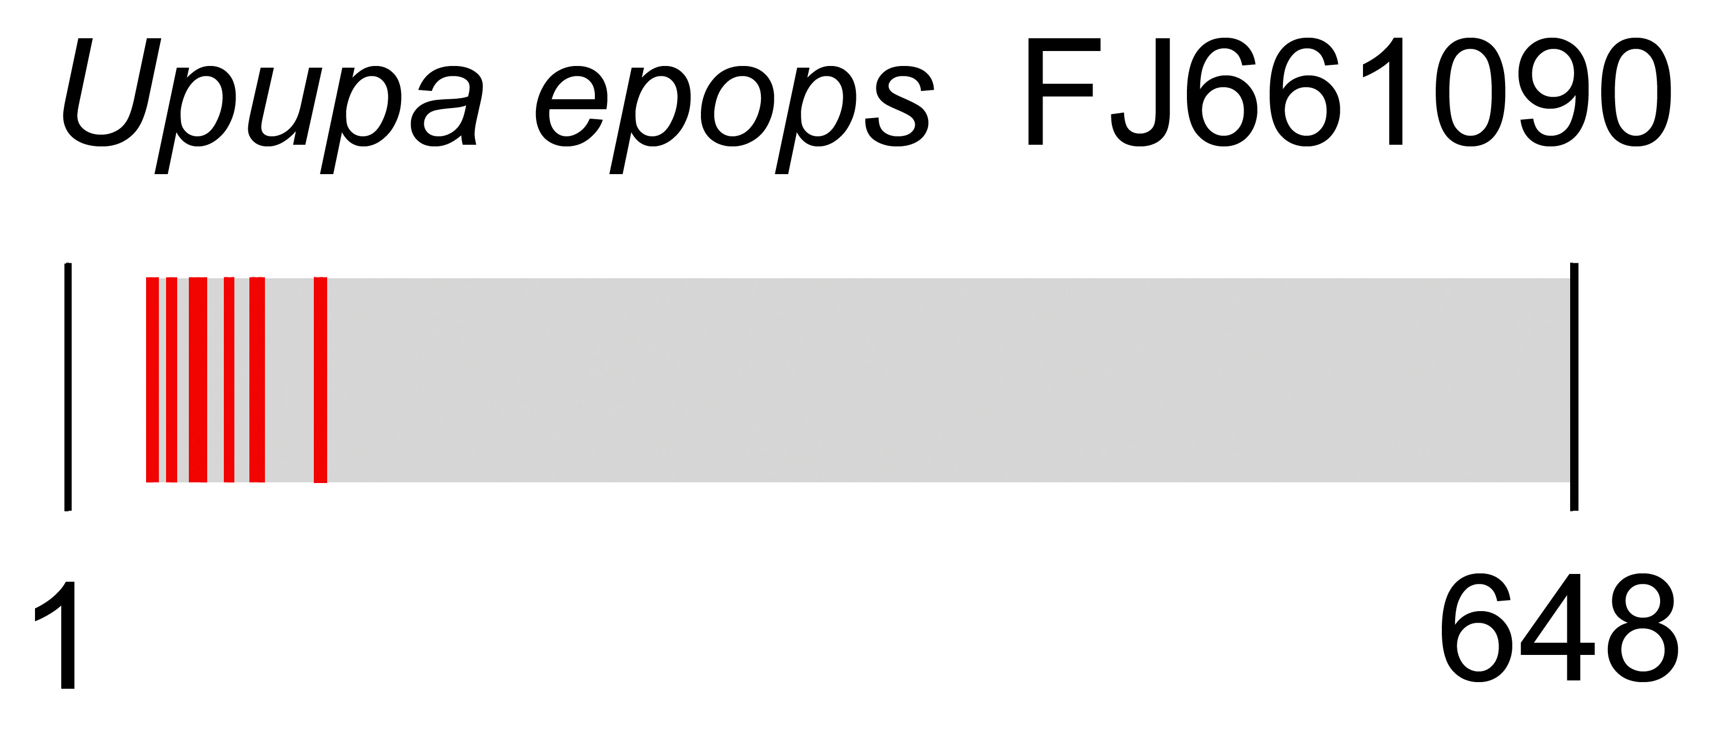
BARCODE Quality Assessment: Frequency Matrix Approach
Mark Y Stoeckle, Rockefeller University
Kevin C R Kerr, Royal Ontario Museum
PLoS ONE August 2012 e43992

Slide 2
Potential BARCODE errors
Taxonomic mislabeling
Pseudogenes
Sequencing Error

Slide 3
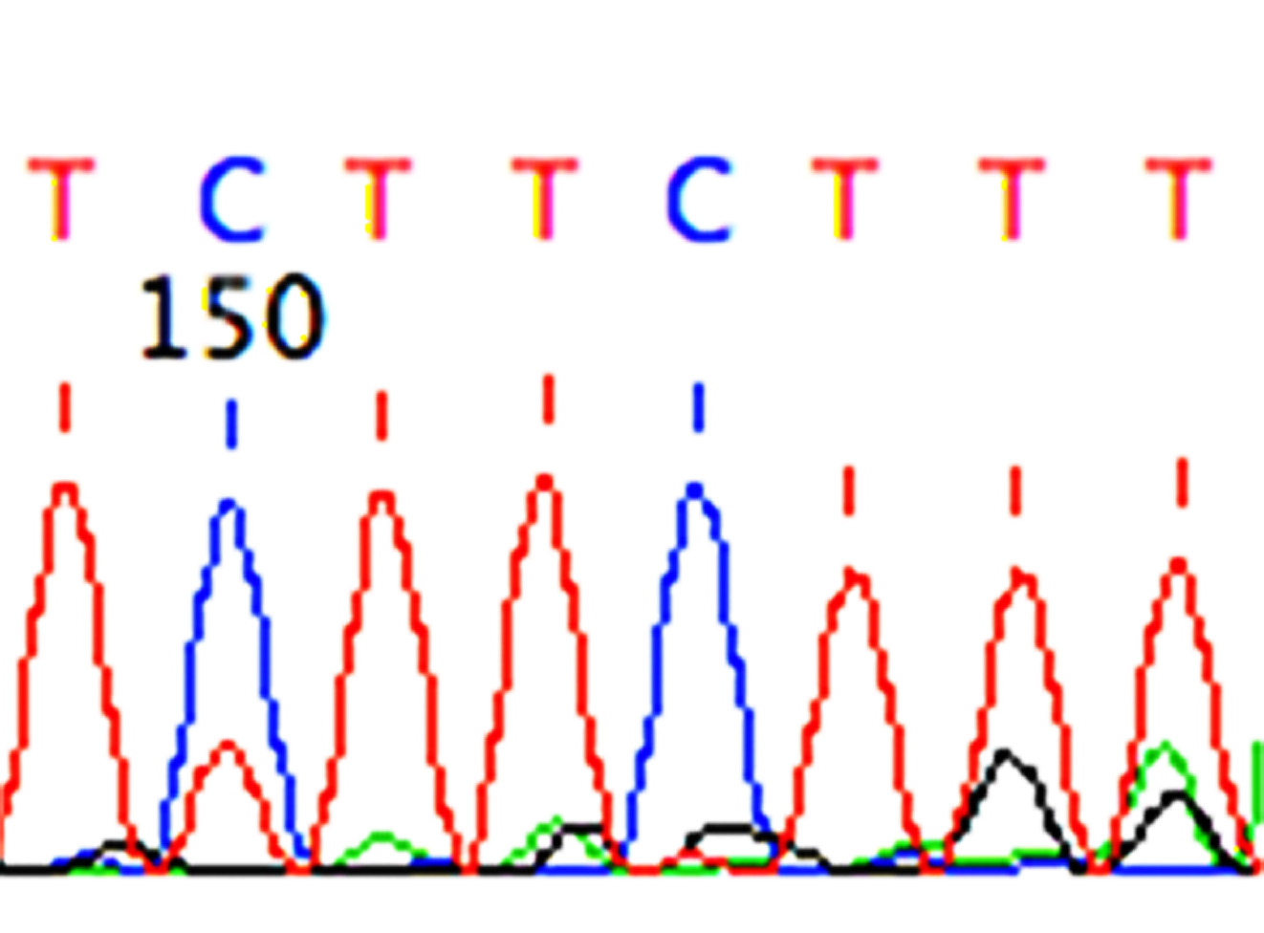
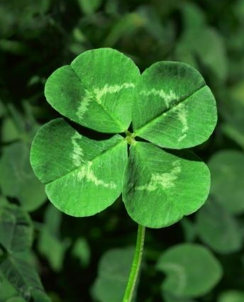
Hypothesis:
Sequencing
Errors
Rare
Variants
=

Slide 4
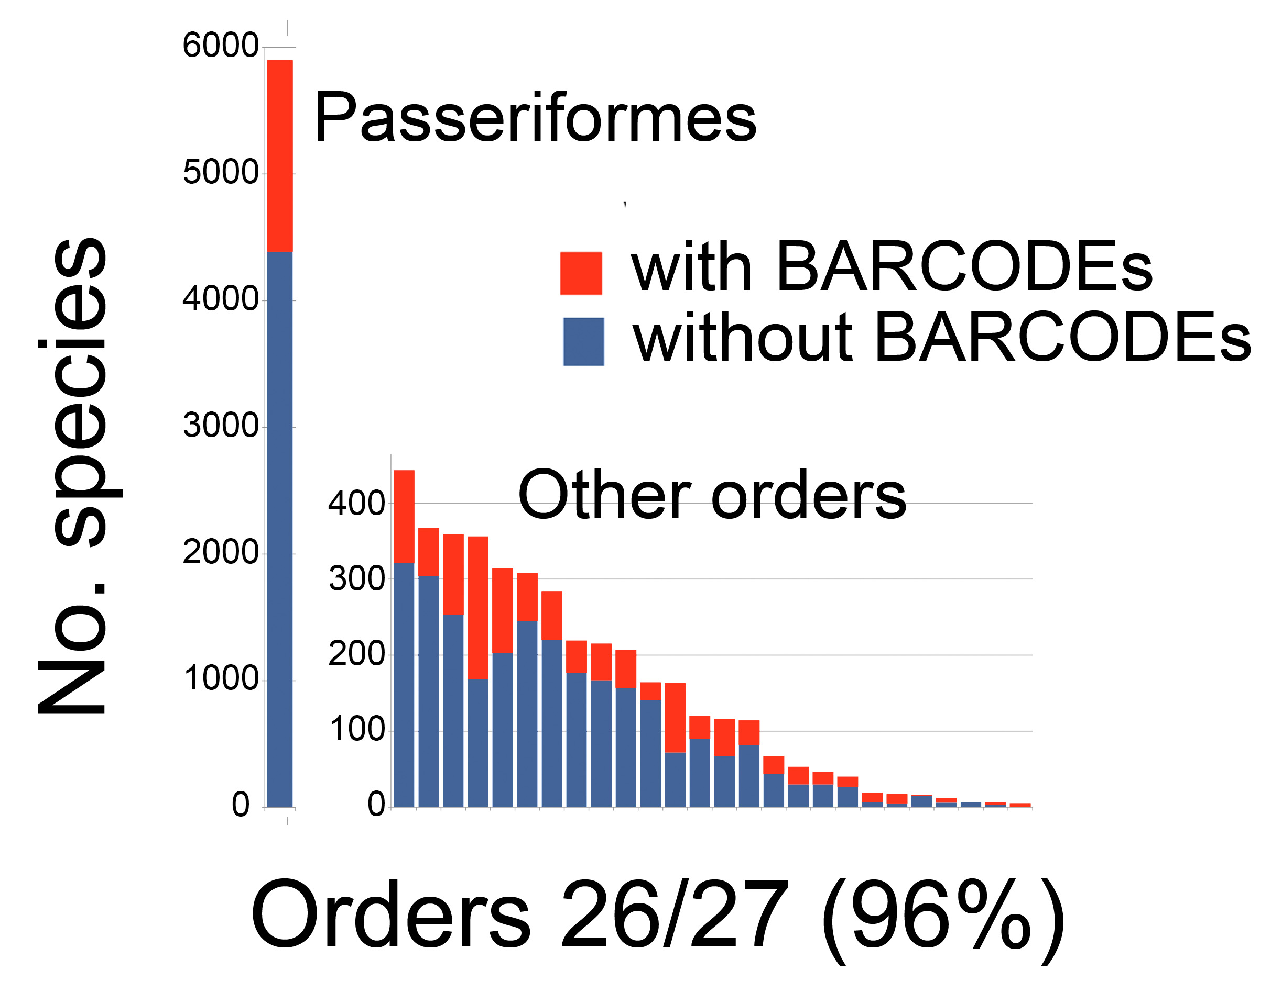
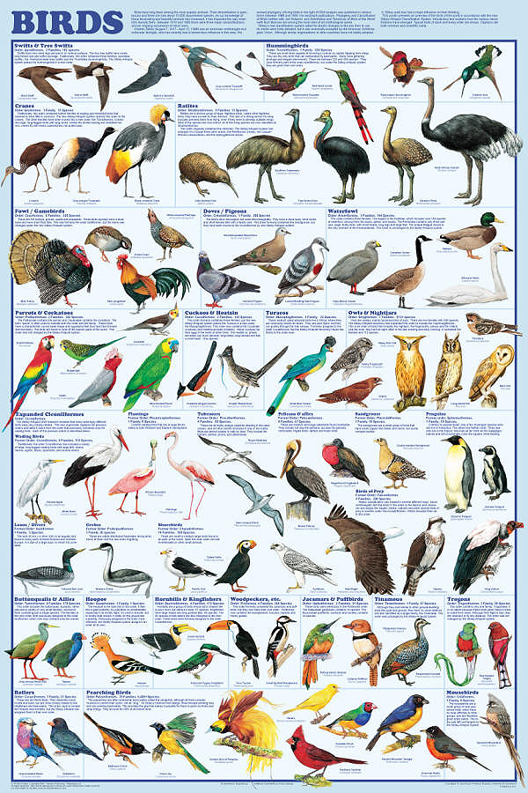
Avian BARCODEs: large, representative dataset 11K records/2.7K species (27% known)

Slide 5
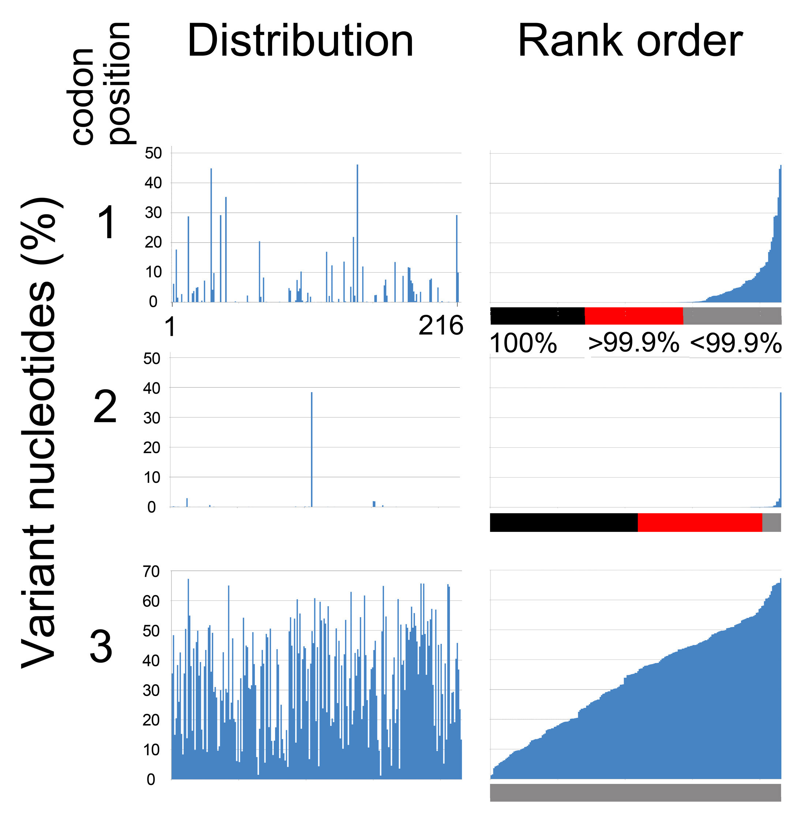
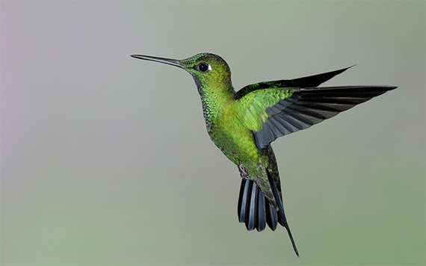
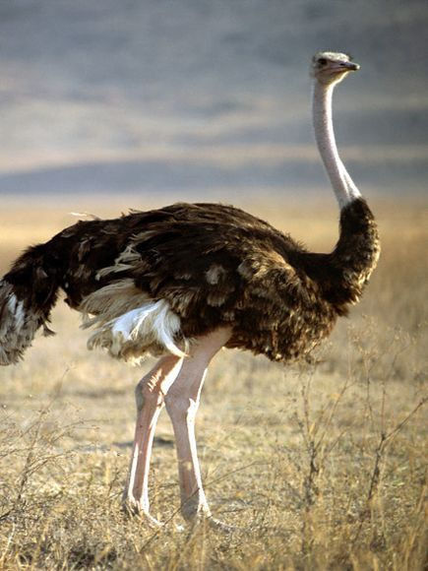
Most 1st, 2nd positions >99.9% conserved

Slide 6
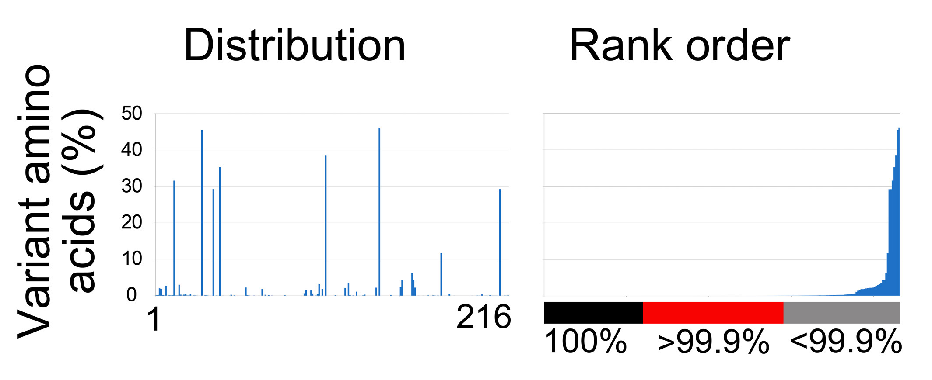
Most aa positions >99.9% conserved

Slide 7
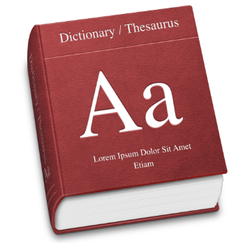
Working definitions
for rare variants:
VERY LOW FREQUENCY VARIANT (VLF): nt, aa in <0.1% seqs at a given position
SINGLETON VLF: in 1 indiv/species
SHARED VLF: in ≥2 indiv/species

Slide 8
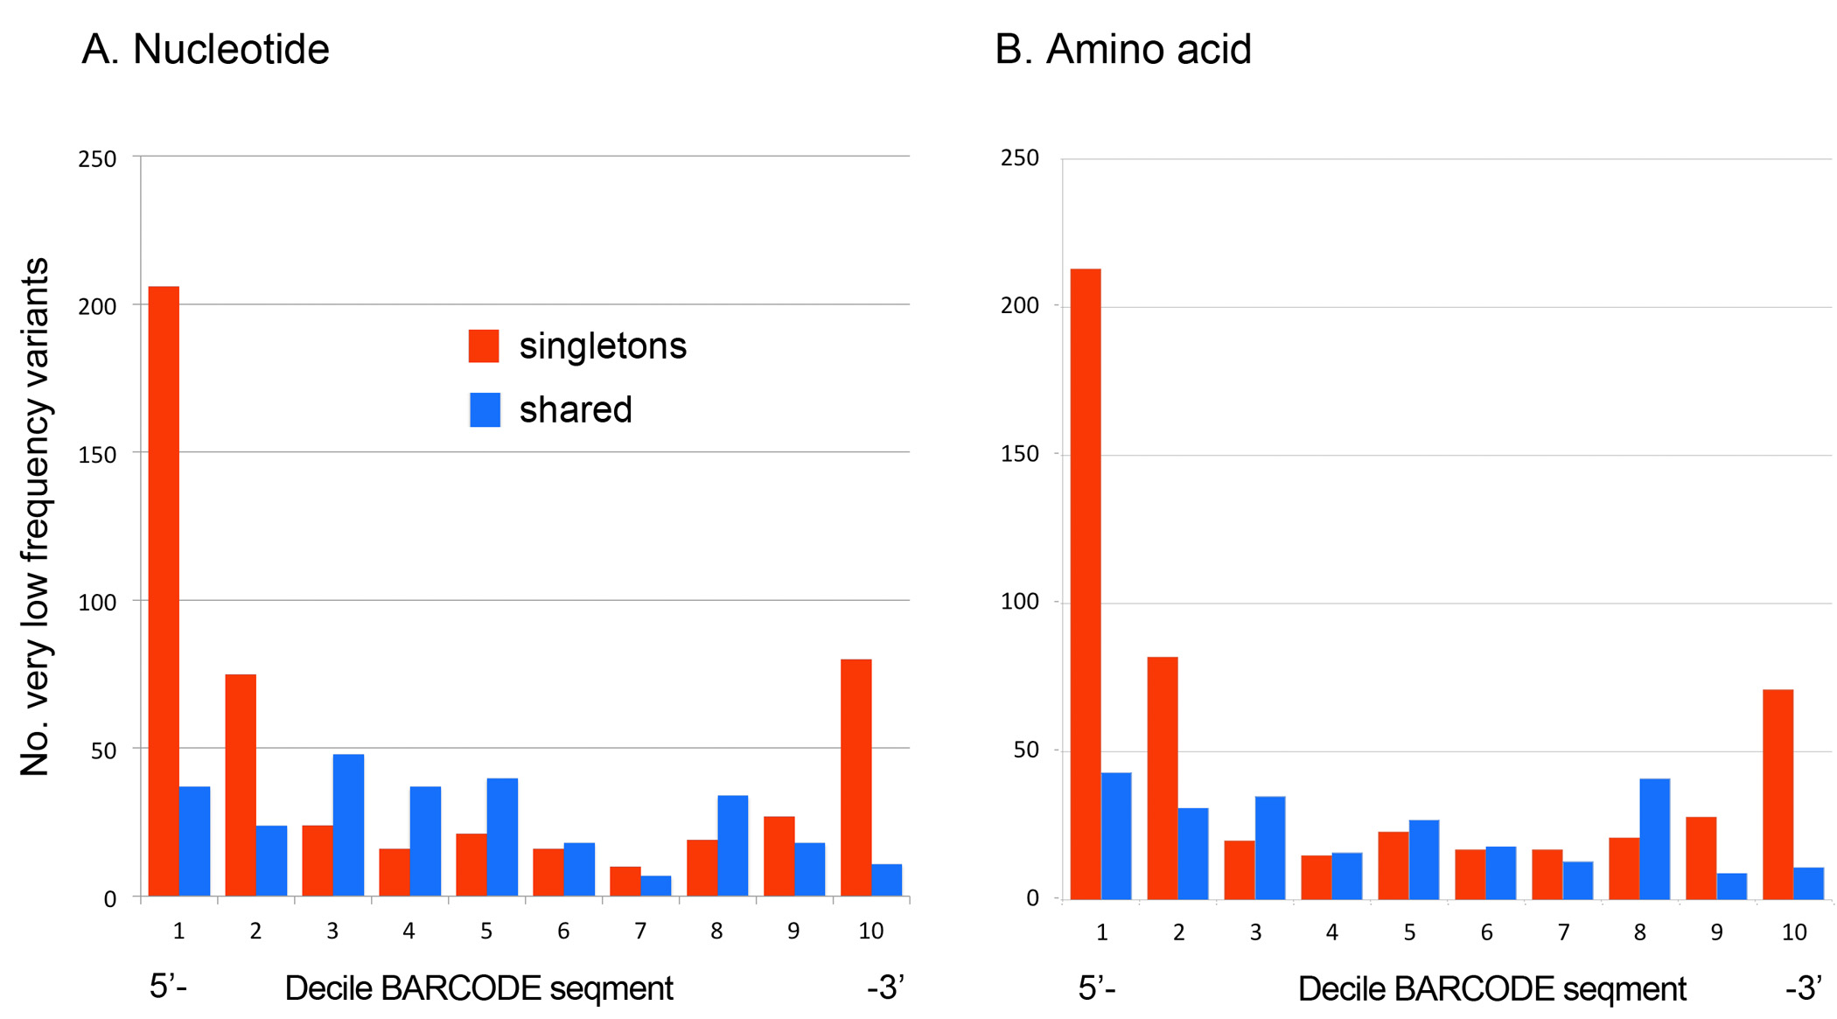
Spatial distribution of VLFs
Singleton VLFs: (mostly) seq error
Shared VLFs: (mostly) biological
Concentrated at ends of segment
Relatively evenly
distributed

Slide 9
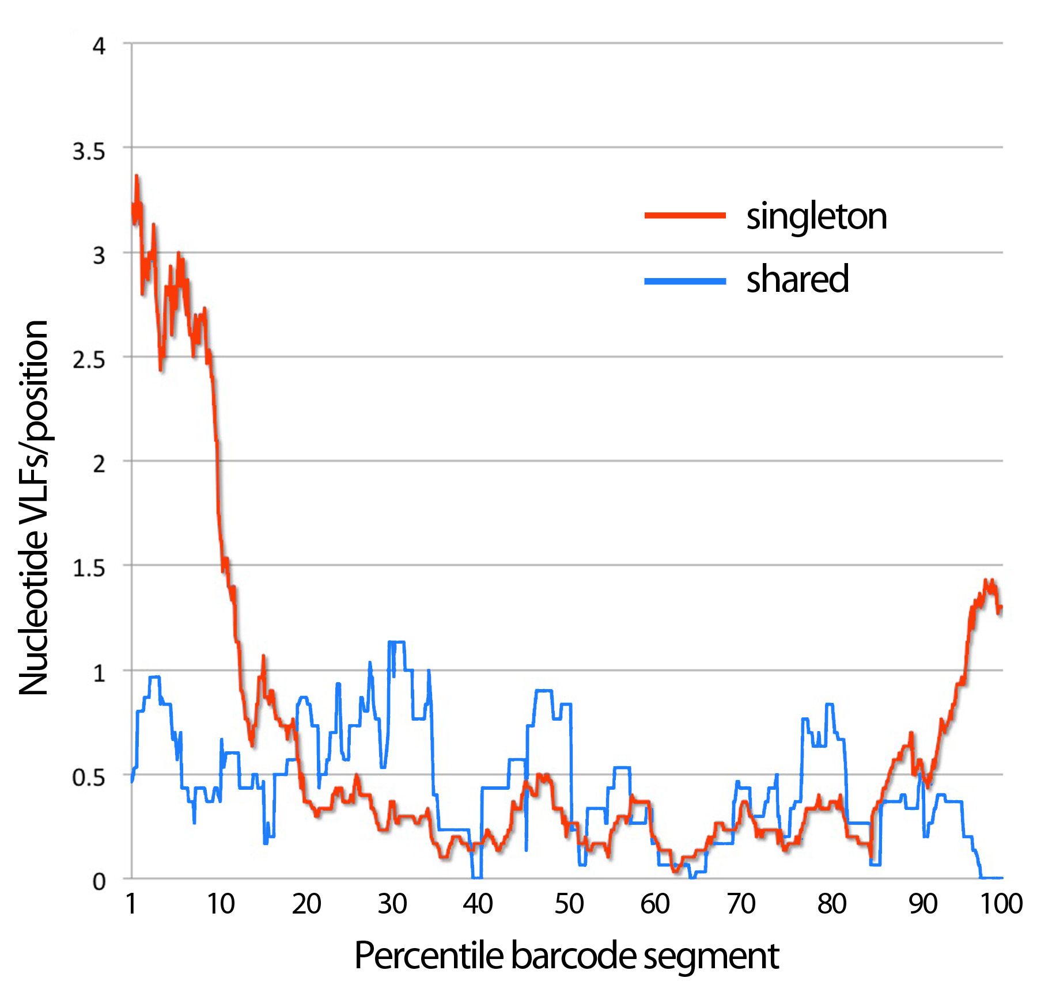
Sliding window analysis nVLFs

Slide 10
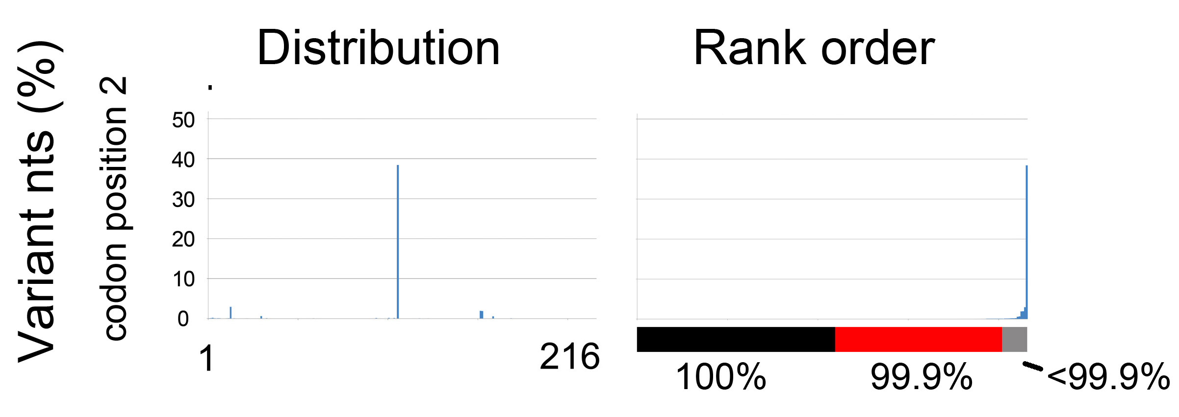
Calculating Error Rate
>
Most (94%) 2nd positions >99.9% conserved
(Nearly) all 2nd position seq errors are VLFs
187 2nd pos si-nVLFs (probable errors) .
216 2nd pos/BC x 10,760 BC
= 8 x 10⁻⁵ errors/base pair

Slide 11
Limitations, Observations
First seq error assessment for BARCODEs
Some singleton nVLFs likely biological—calc rate is upper limit
~3% BARCODEs ≥ 1 error (av 1.7/BARCODE)
Seq errors unlikely to affect species ID
Increased apparent intraspecific variation

Slide 12
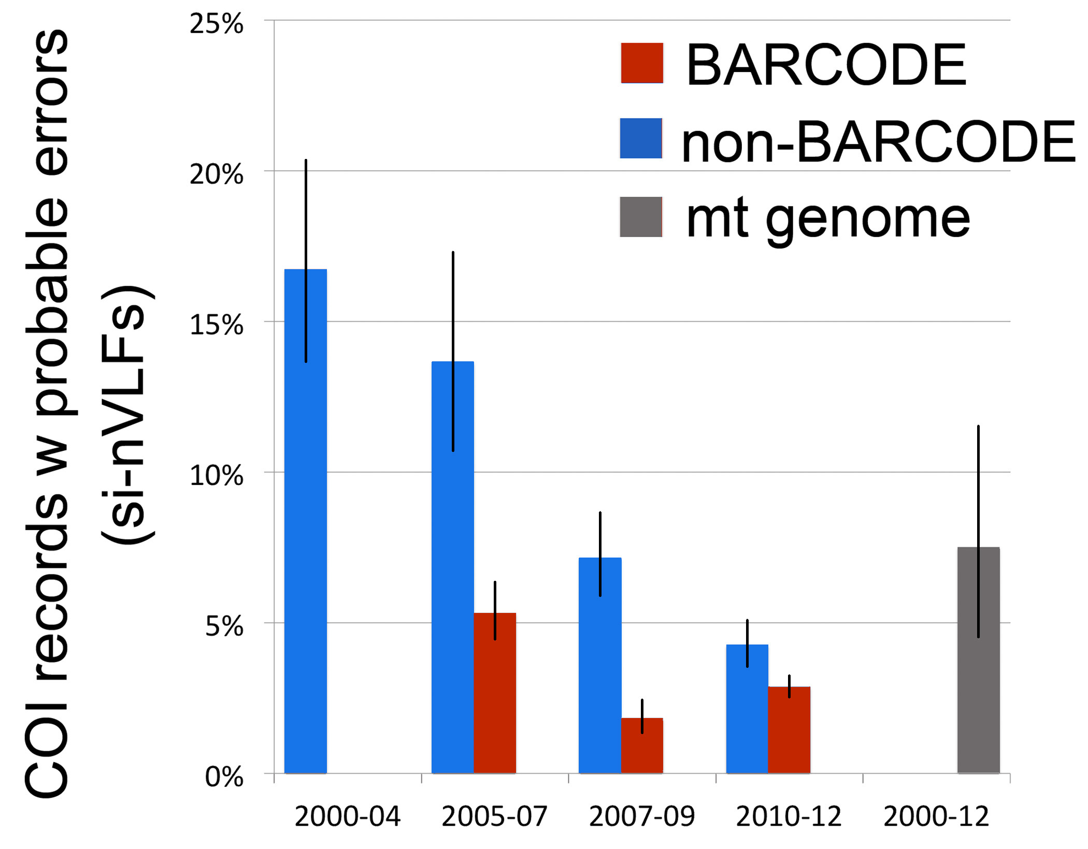
Applications: 1. Compare database quality
Error bars
=95% CI

Slide 13
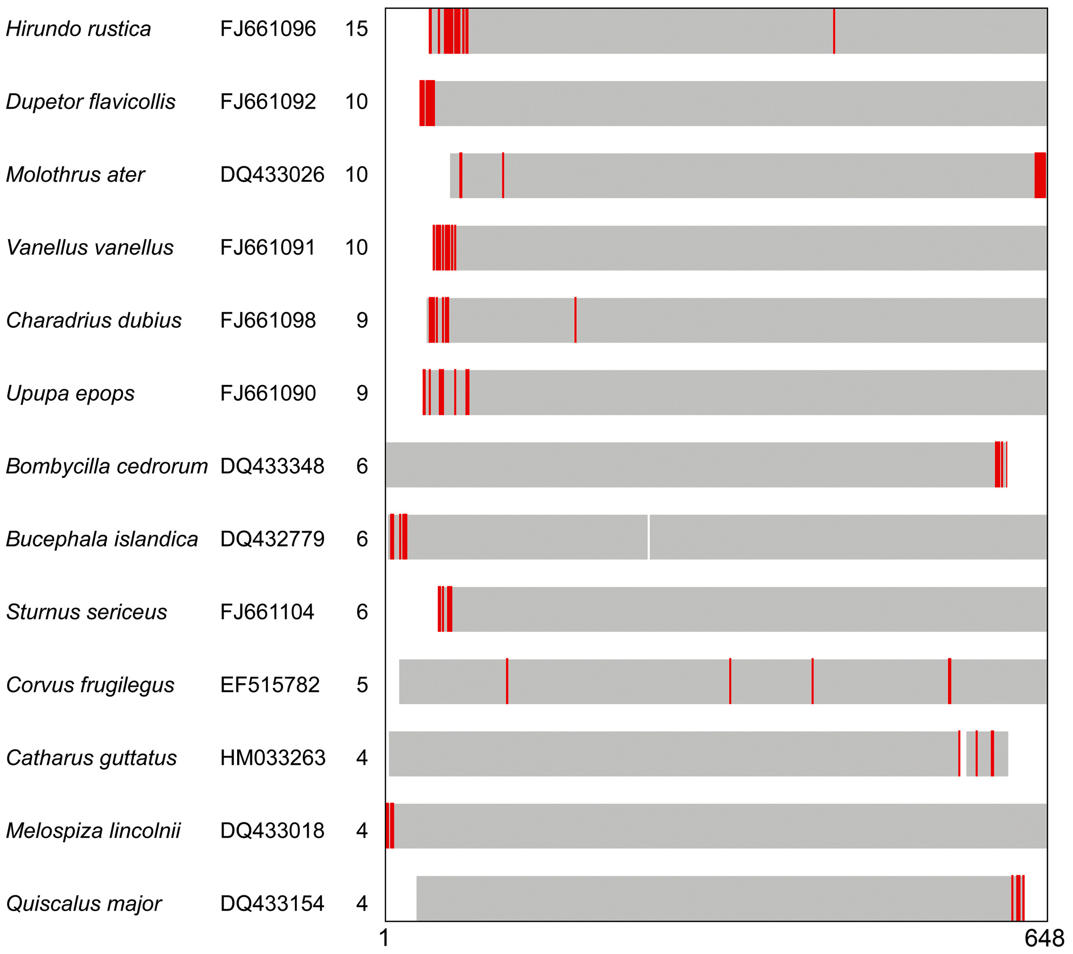
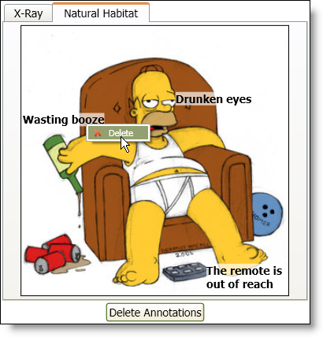
2. Highlight BARCODEs w probable errors--annotate?
Annotated
Homer Simpson
Portrait

Slide 14
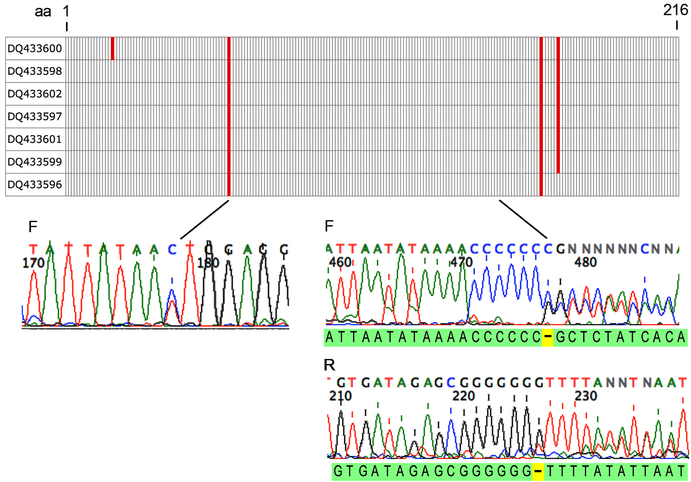
3. BONUS: cryptic pseudogenes flagged by multiple SHARED VLFs
Alder flycatcher (Empidonax alnorum)

Slide 15
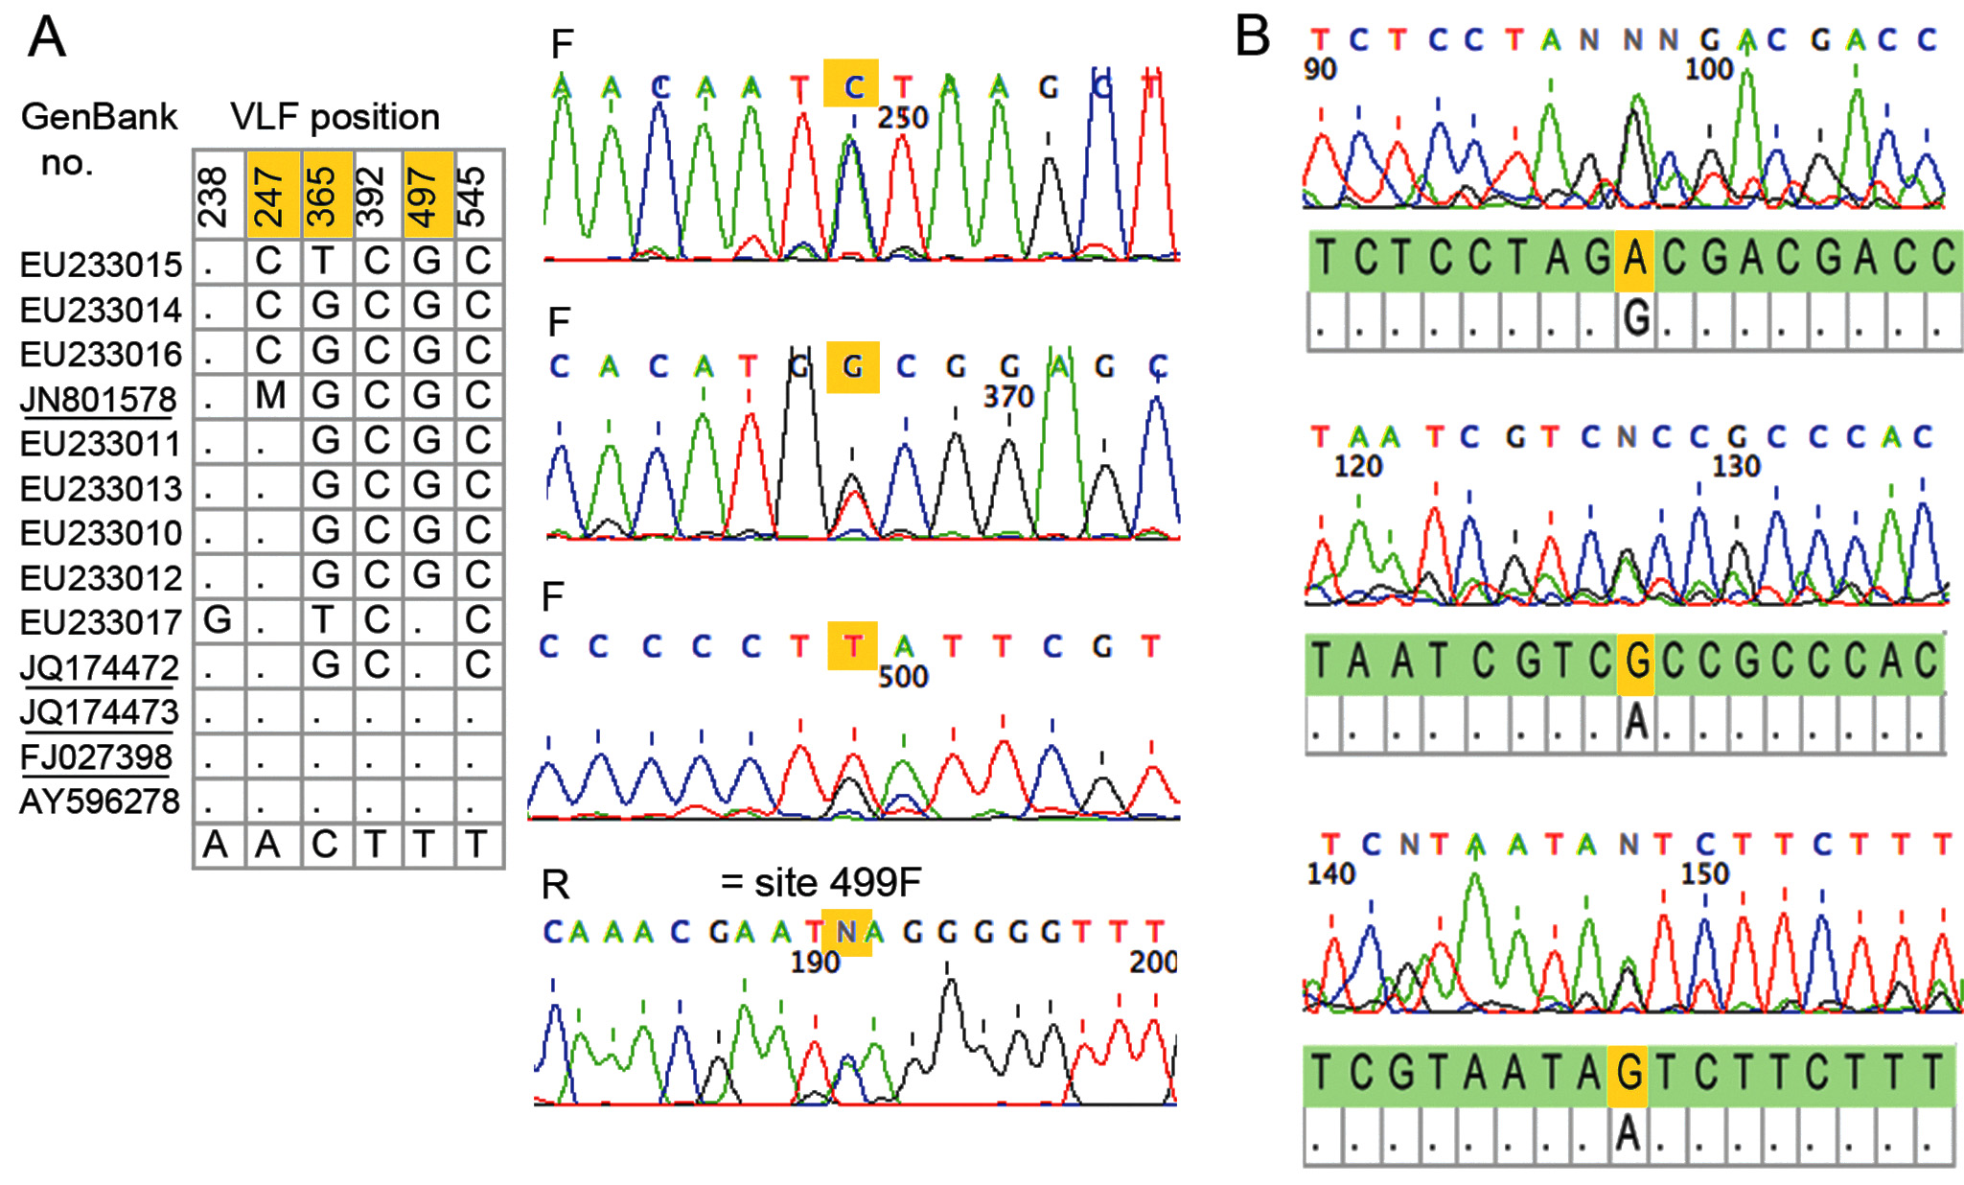
Cryptic pseudogenes uncommon: 0.1% BARCODEs
Fuscous flycatcher (Cnemotriccus fuscatus) Canada goose (Branta canadensis)

Slide 16
Conclusions
Avian BARCODE sequence quality high and improving
Frequency matrix potential utility for sequence database QA
Caution on studies involving rare variants

Slide 17
Acknowledgments
Natural Sciences and Engineering
Research Council of Canada
Alan Baker Jan Lifjeld
Arild Johnsen Per Ericson
Carla Dove Gary Graves
Pablo Tubaro Dario Litjmaer
Jesse Ausubel

