Slide 1
FISH STORY
Kate Stoeckle and Louisa Strauss
Johns Hopkins University
Presented at AAAS Annual Meeting, San Diego, CA, February 19, 2010

Slide 2
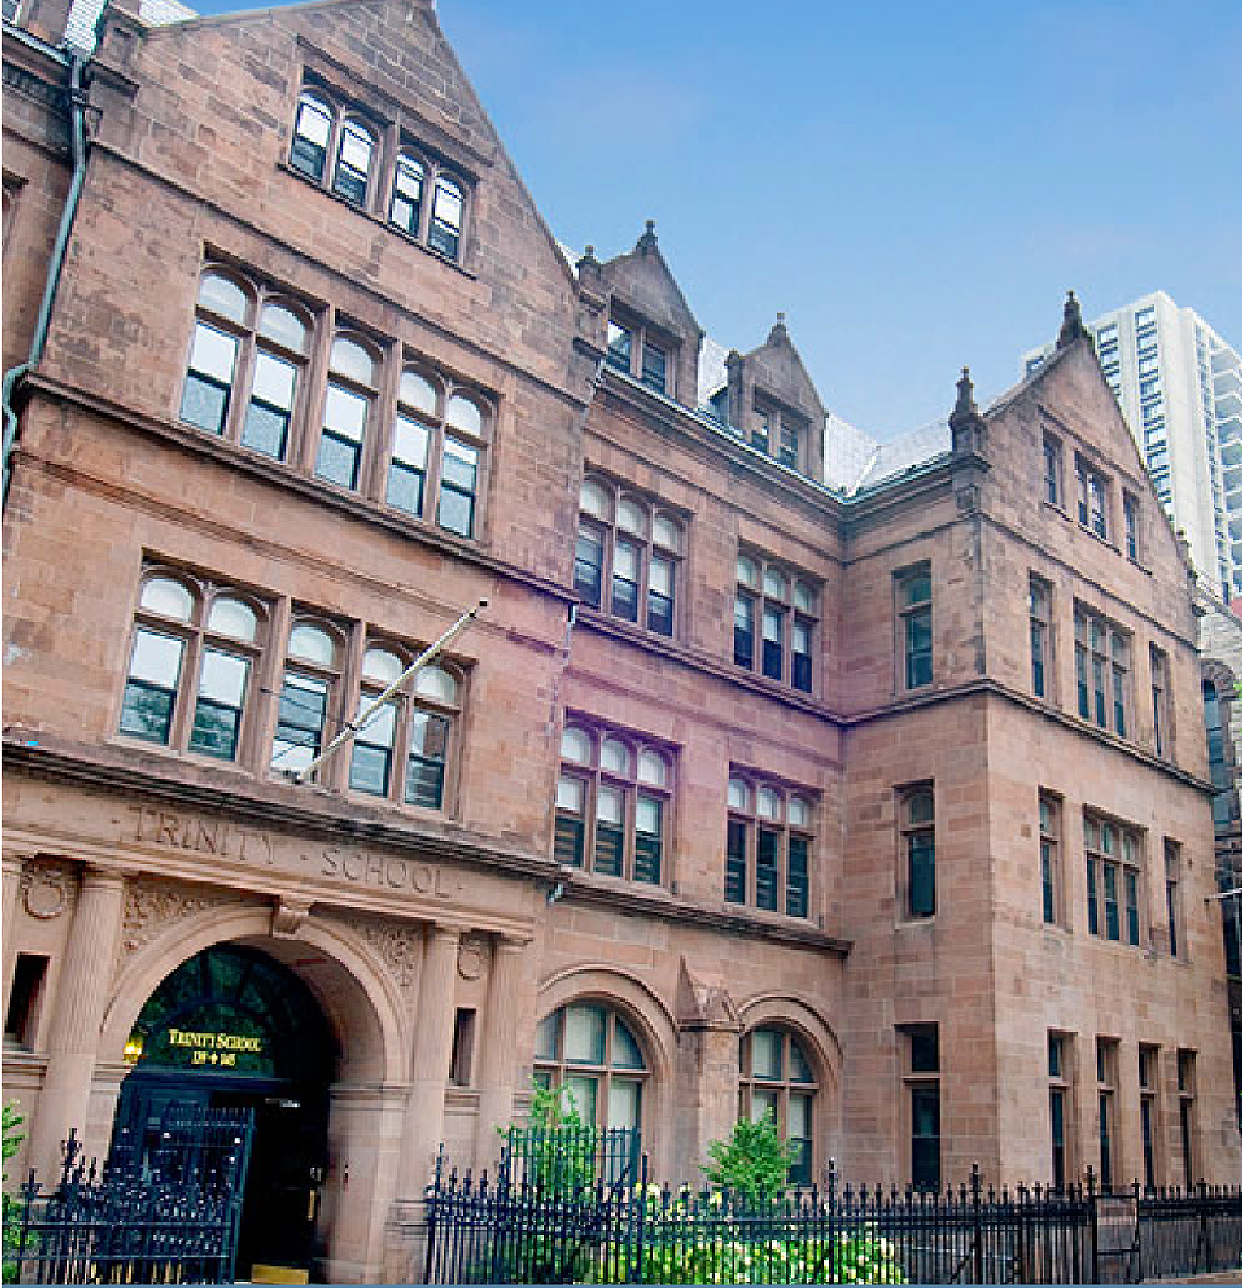
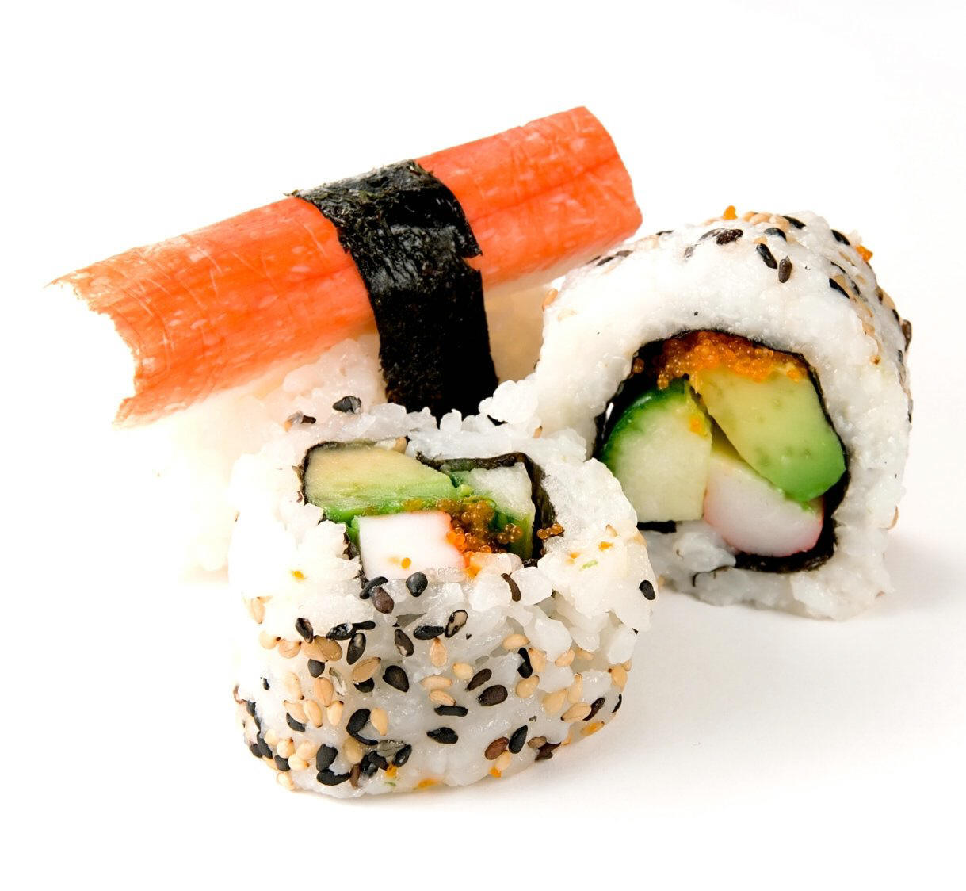
Trinity School, NYC
March 2007
11th grade
Can we identify sushi with
DNA barcoding?

Slide 3
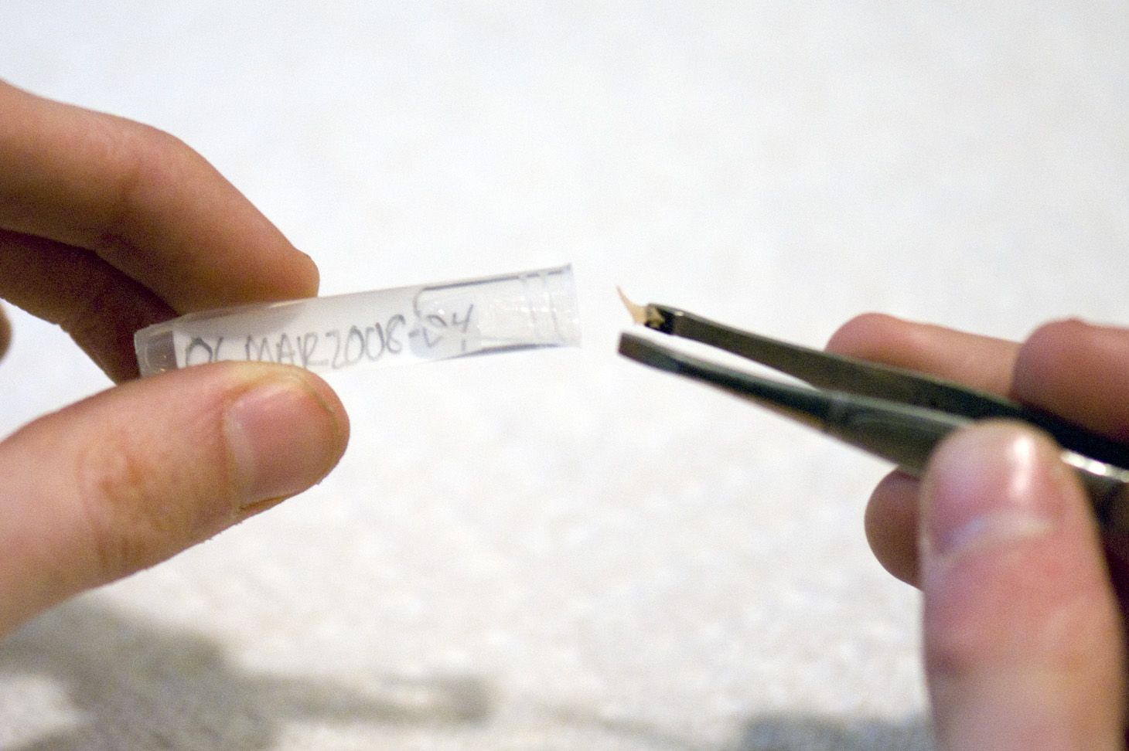
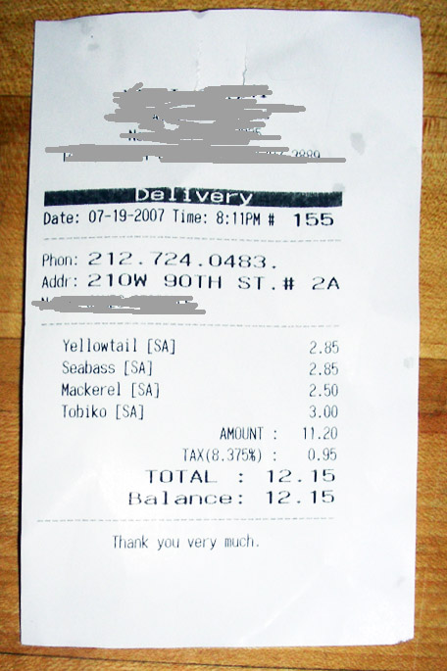
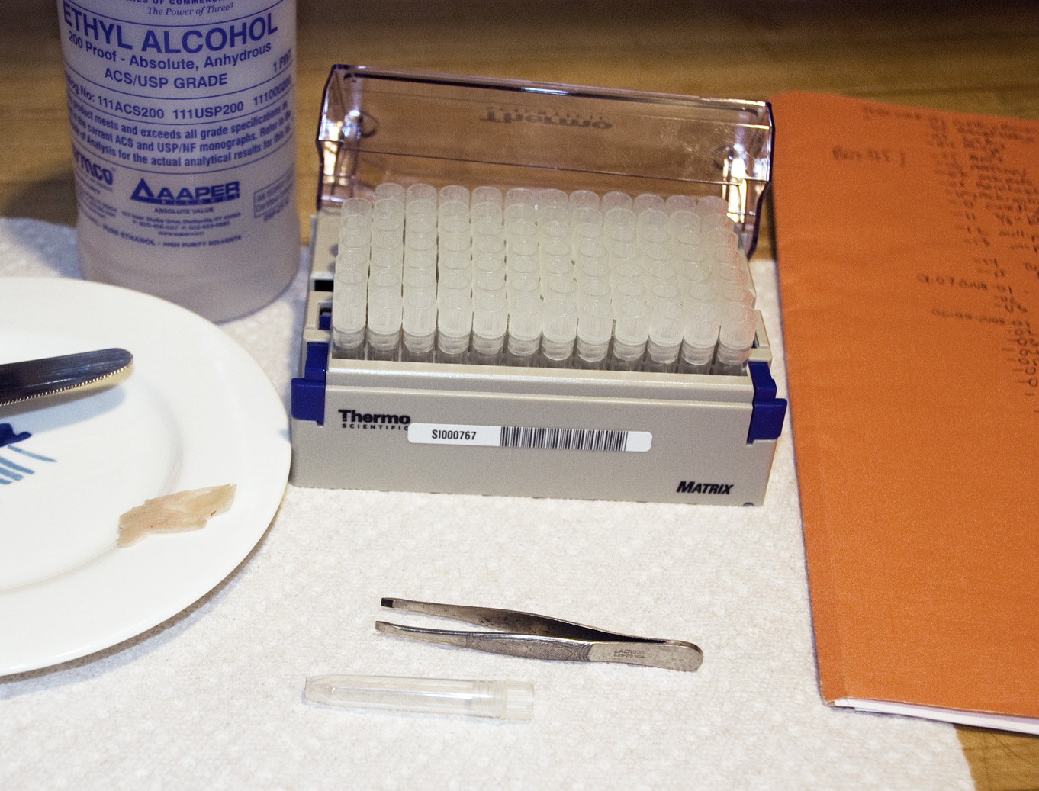
What we did
1. Shop (and eat)
2. Sample
➔
3. Document
➔

Slide 4
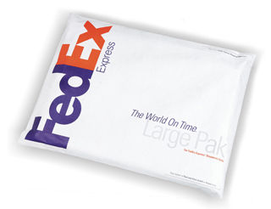
4. Sequence
5. Match to database

Slide 5
What we found
-One-quarter of samples mislabeled,
all as more expensive or more
desirable fish
-Mislabeling in 6/10 grocery stores/
fish markets and 2/3 restaurants

Slide 6
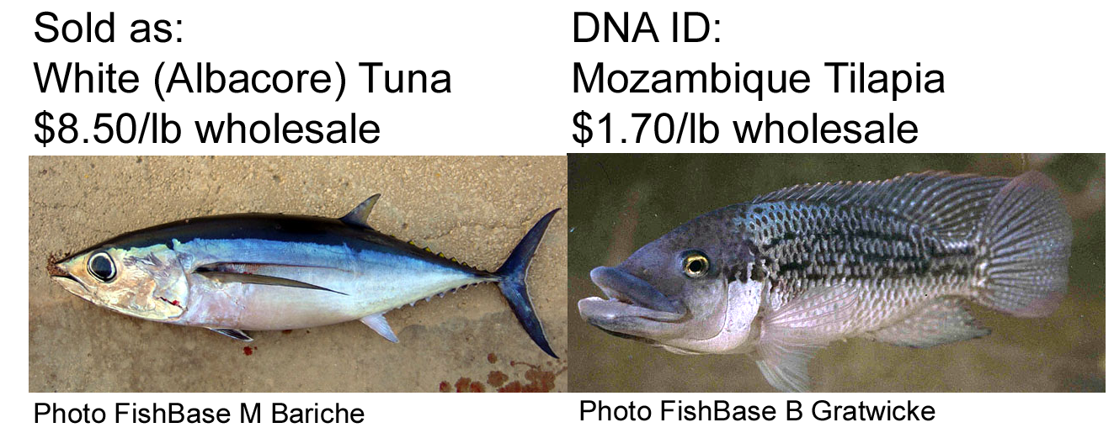
For example

Slide 7
Diverse items mislabeled
Lavender Jobfish, Slender Pinjalo (SE Asia), Acadian Redfish (N Atlantic), Nile Perch (Africa) sold as Red Snapper (Caribbean)
Caribbean Spotted Goatfish sold as “Mediterranean Red Mullet”
White Bass (farmed freshwater fish) sold as “Sea Bass”
Smelt Roe sold as “Flying Fish Roe”

Slide 8
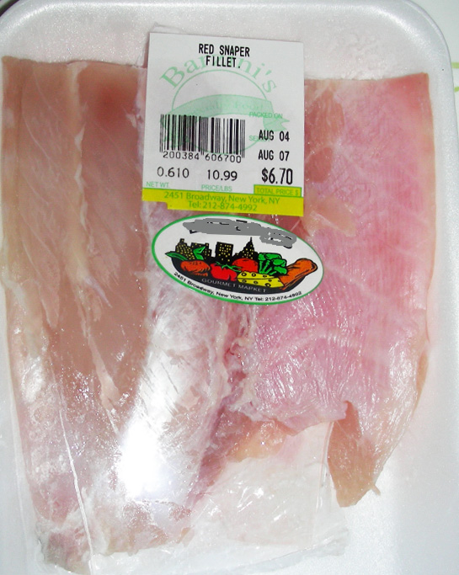
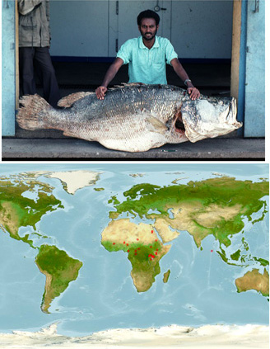
For example
Label: Red Snapper
DNA ID: Nile Perch
FishBase: John Casselman
Range map: FishBase

Slide 9
What we wrote
Our results in scientific report

Slide 10
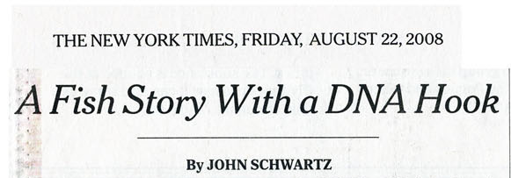
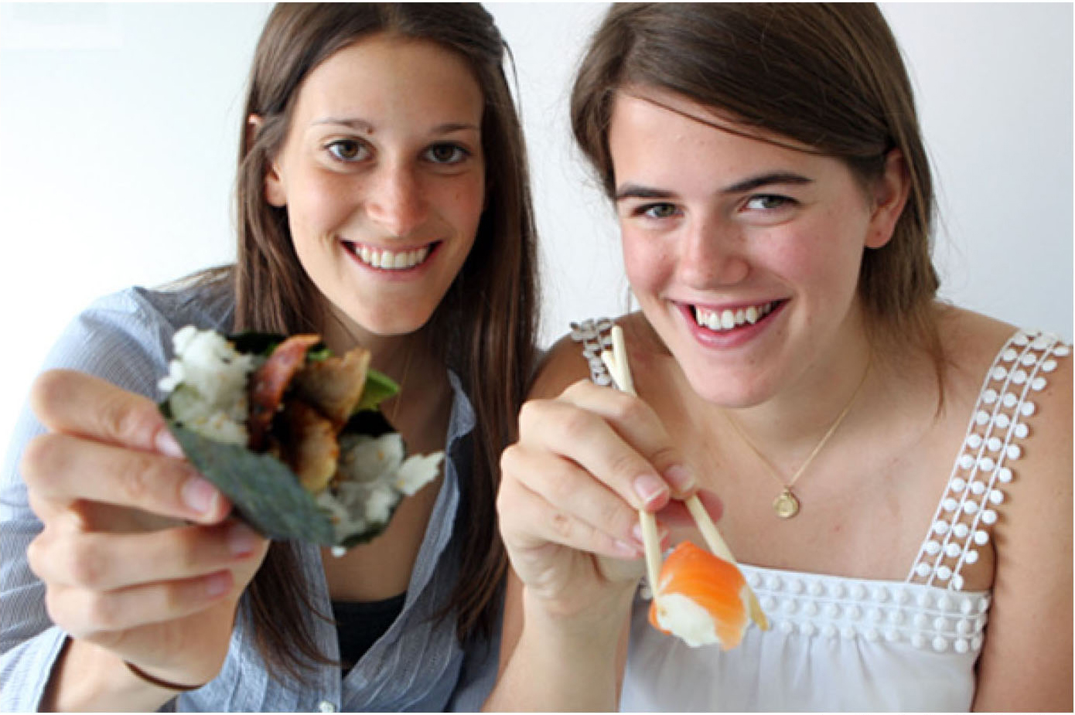
Our study attracts interest
Page 1

Slide 11
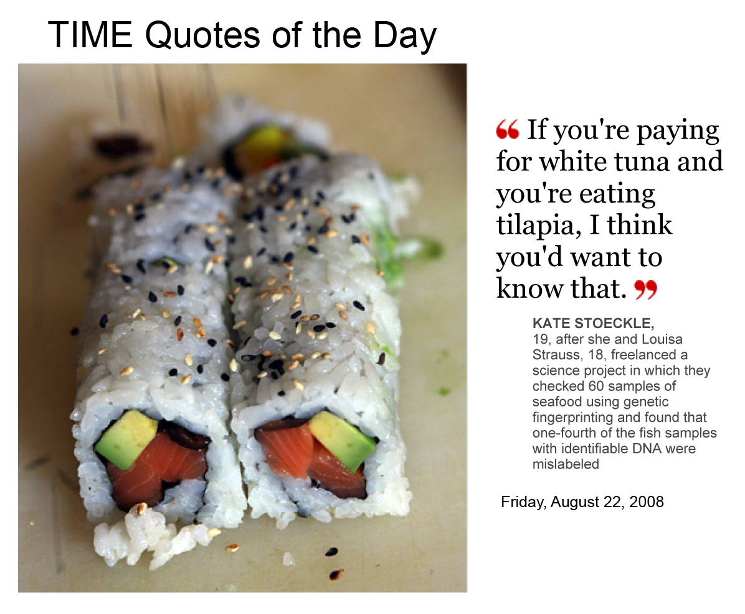
Kate Stoeckle
and
Louisa Strauss
August 22, 2008

Slide 12
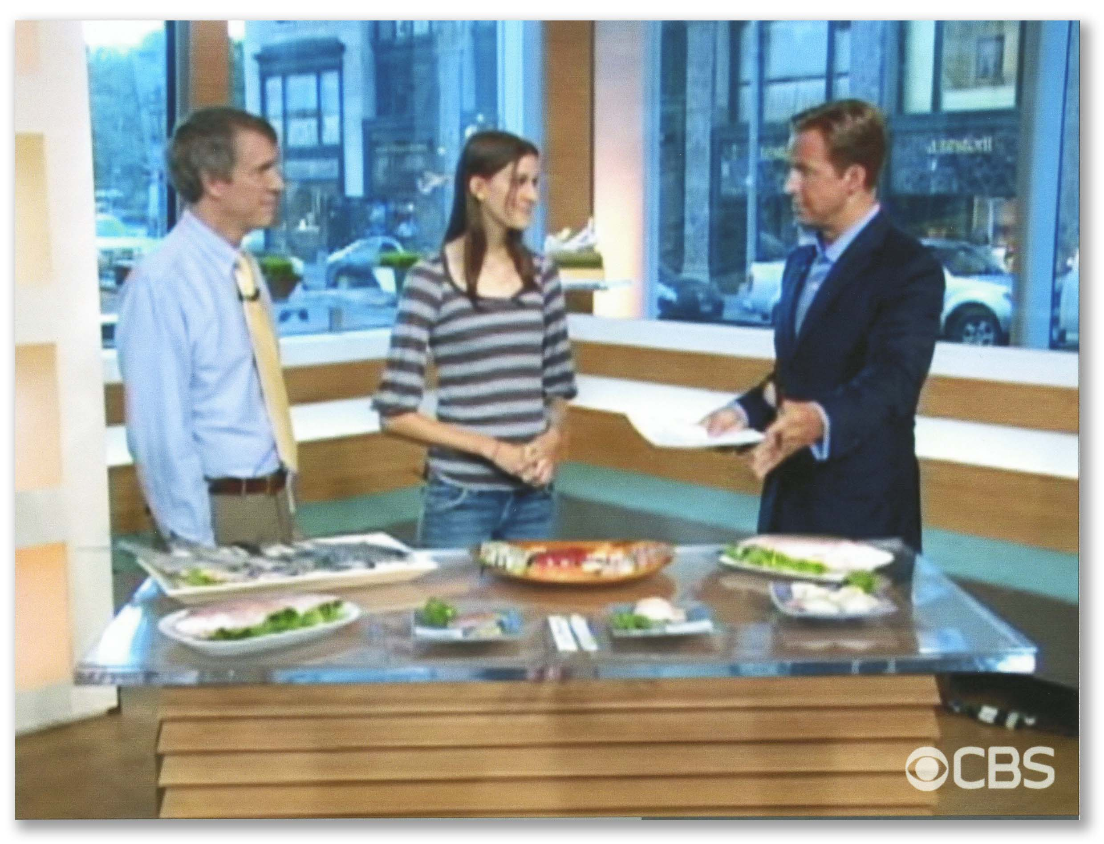
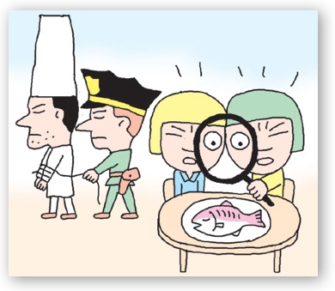
Korean Daily News
CBS Early Show
>380 tv, radio, print, and online media reports in 10 languages and 34 countries
Press named it “Sushi-gate”

Slide 13
Our study inspired others
A DNA Barcoding Analysis of Commercially-Sold Fish
Thomas Jefferson High School, Alexandria, VA
June 2009

Slide 14
DNA Barcoding + students =
Learn science
Make discoveries
Have fun

Slide 15
Acknowledgments

