Slide 1
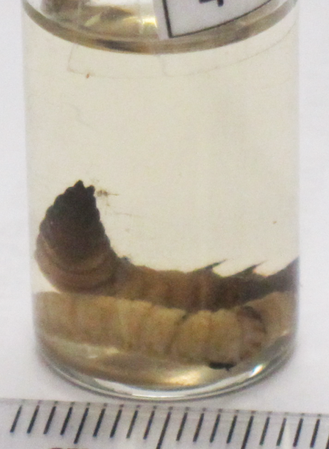
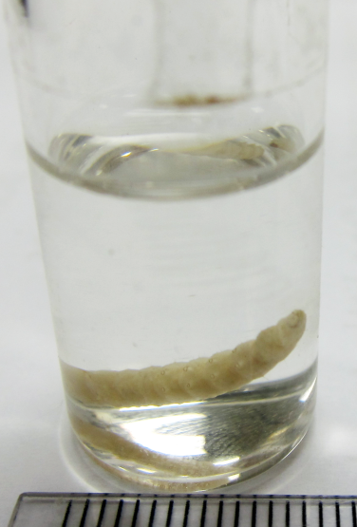
Barcode IDs Matched Morphology
RT15
RT18
RT27
RT29
Dermaptera
(earwig)
GB 99%
BOLD 100%
Diaphania nitidalis
(Pickleworm)
GB 97%
BOLD 99%
Isoptera
(termite)
BOLD 99%
Cydia Splendana
(Chestnut tortrix)
GB 98%
BOLD 98%

Slide 2
3 Barcode IDs Added Taxonomic Resolution
Morphology
Order
Hemiptera
(true bugs)
50,000 species
Family
Phoridae
(humpbacked flies)
4,000 species
Genus
Bactrocera
(fruitflies)
551 species
DNA Barcode
Species
Anasa scorbutica
(squash bug)
BOLD 99%
Species
Megaselia scalaris (coffin fly)
GB, BOLD 99%
Species
Bactrocera latifrons (Malaysian fruit fly)
GB, BOLD 100%
RT21
RT28
RT19

Slide 3
Acknowledgments
I want to thank everyone who has made my project possible including:
The Officers from:
U.S. Customs and Border Protection Newark International Airport
Frances Krim Memorial Inspection Station
My mentor:
Dr. Mark Stoeckle
The Program for the Human Environment, Rockefeller University
The collaborators from:
DNA Learning Center
Cold Spring Harbor Laboratory
Harlem DNA Laboratory
Genspace
American Museum of Natural History Alfred P. Sloan Foundation

