Slide 1
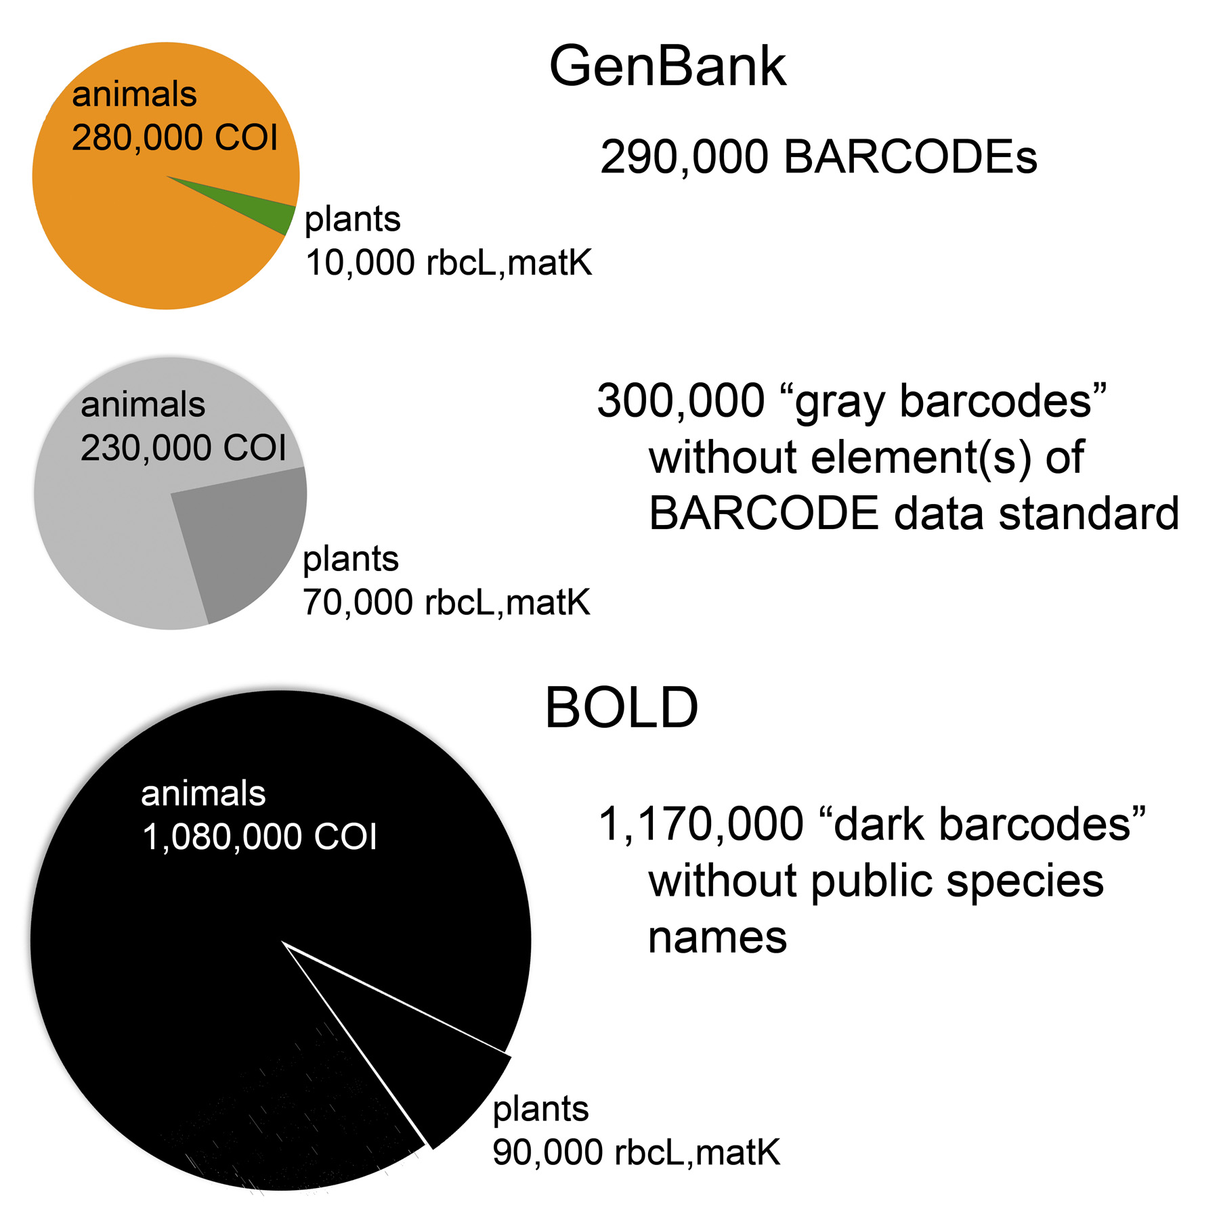
How many specimens with barcodes?

Slide 2
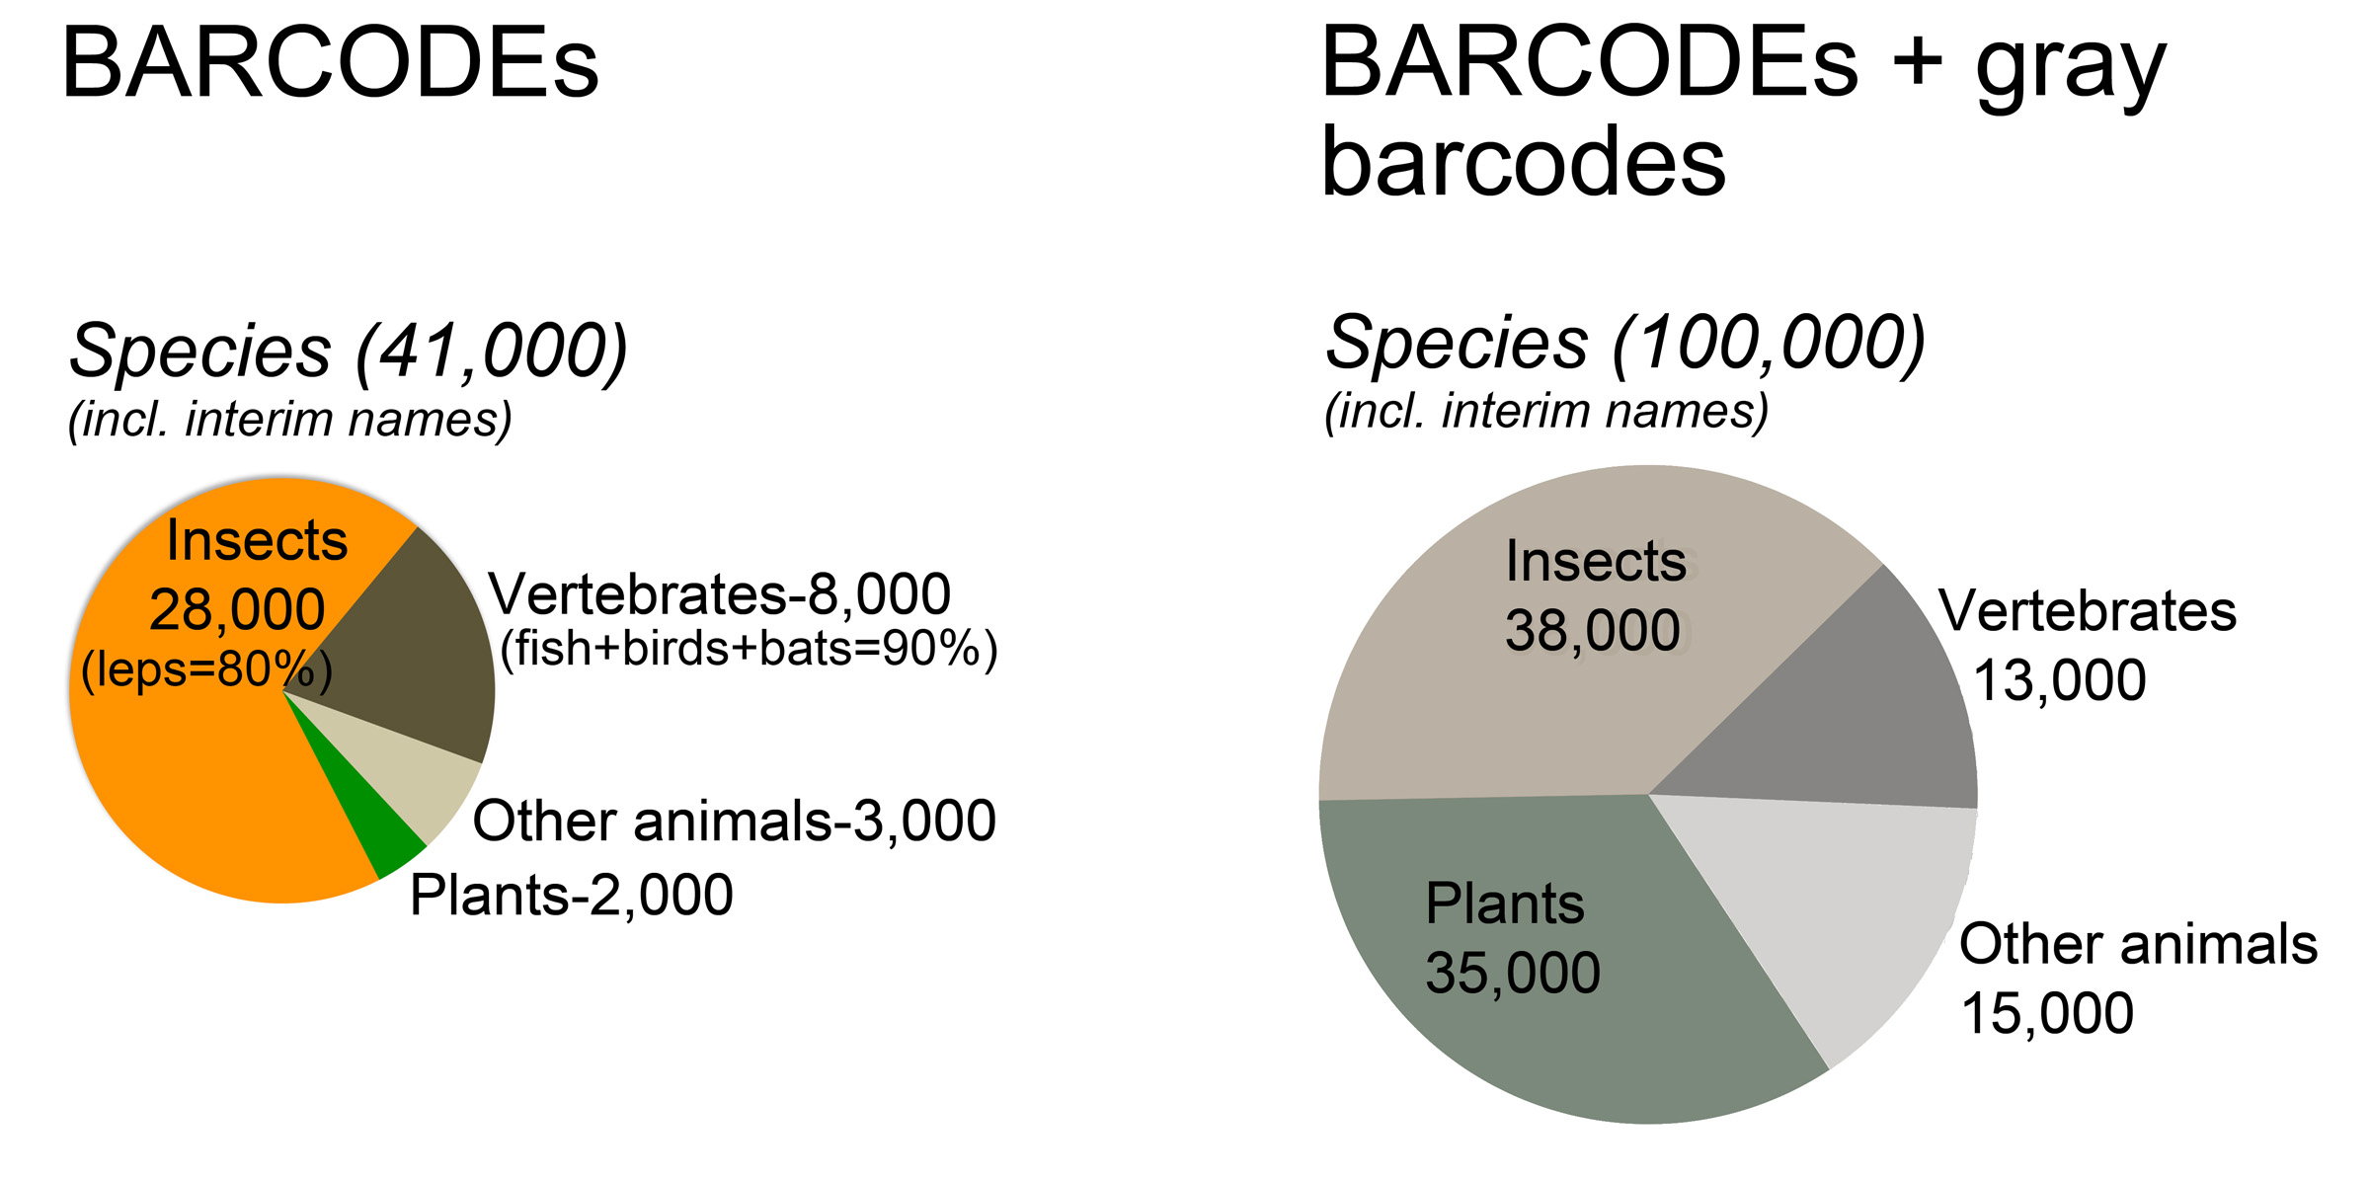
How many species with barcodes?

Slide 3
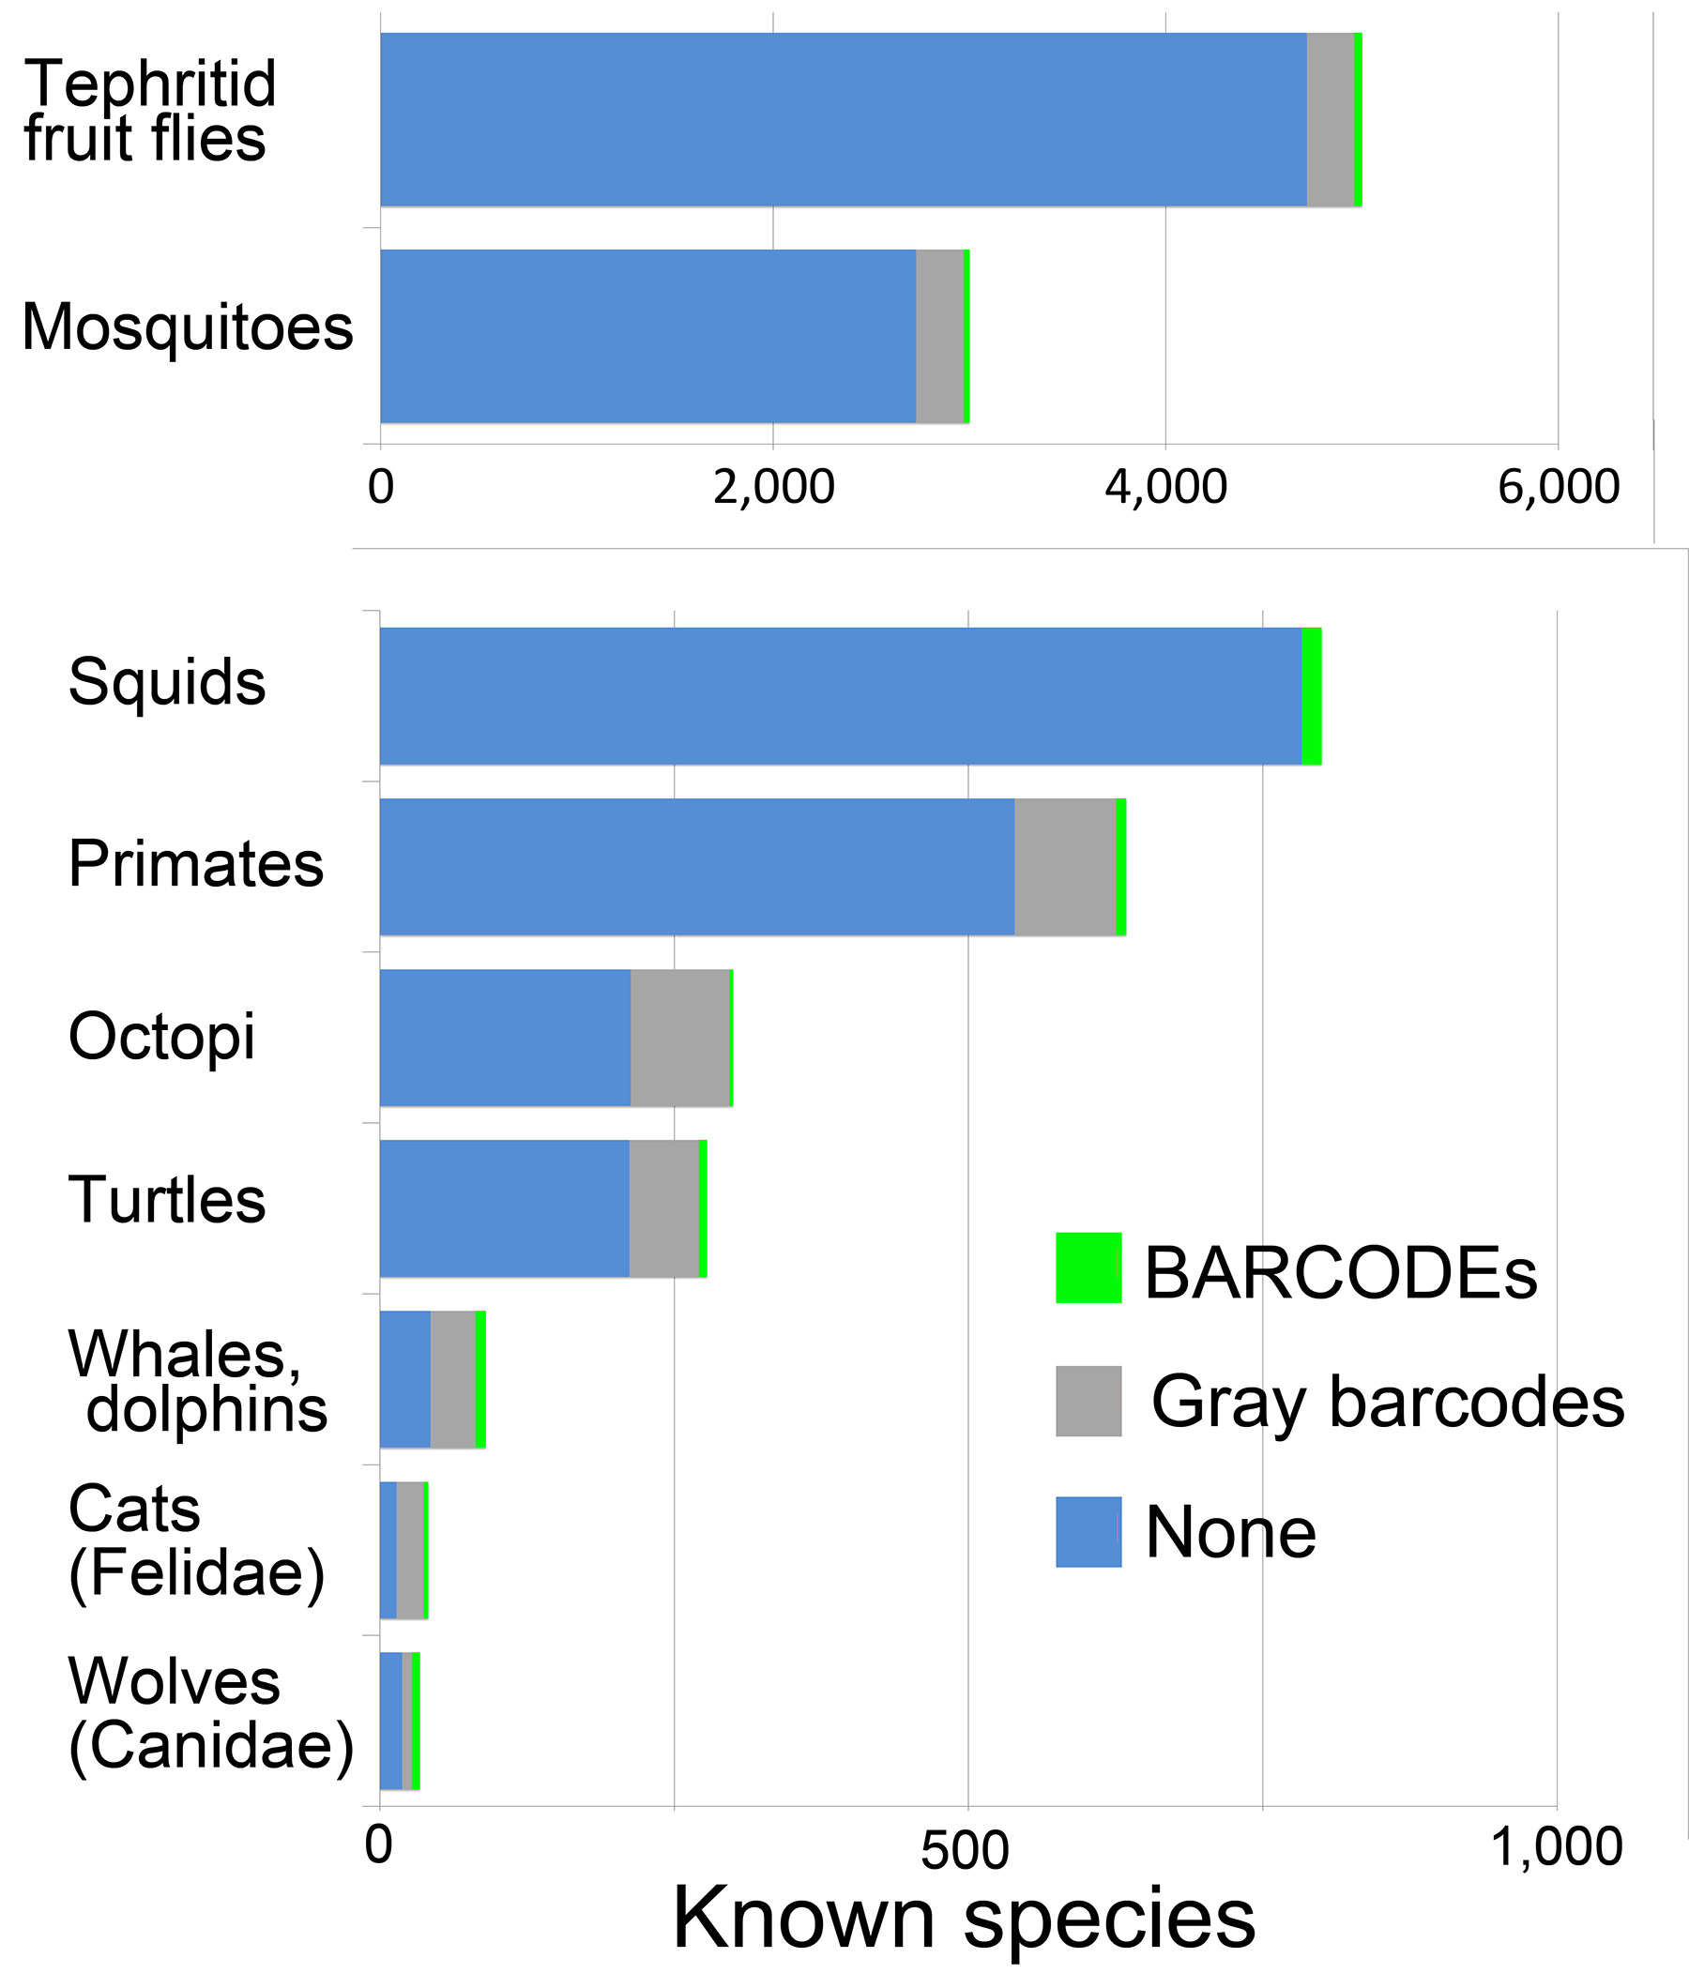
What groups have few barcodes so far?

